Slide 1
A study on the modeling of the distribution automation systems using Petri Nets
Student: Huiyuan Xiao
Professor: Prof. Antonello Monti
Supervisor: Abhinav Sadu
Huiyuan Xiao
Notes:
Good afternoon!everyone.
My name is Xiao Huiyuan,welcome to my master thesis presentation:a study on the modeling of the distribution automation systems using Petri Nets.
My supervisor is Mr.Sadu,thank you so much for your kindly help!

Slide 2
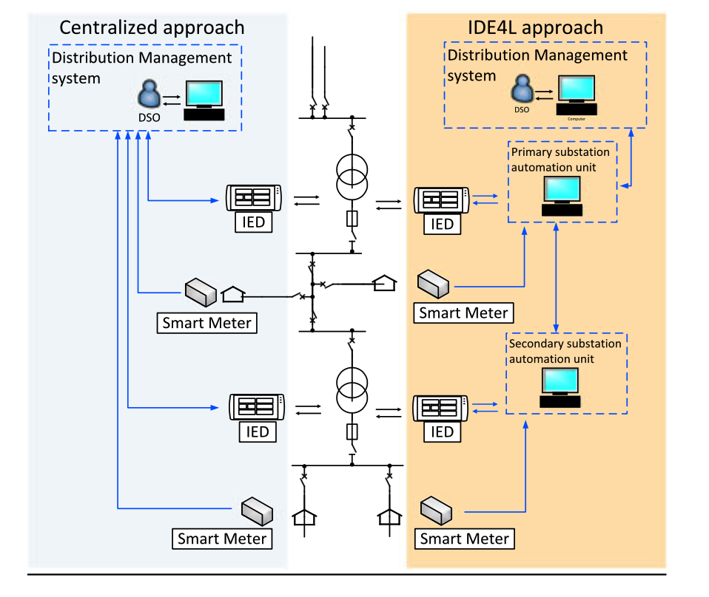
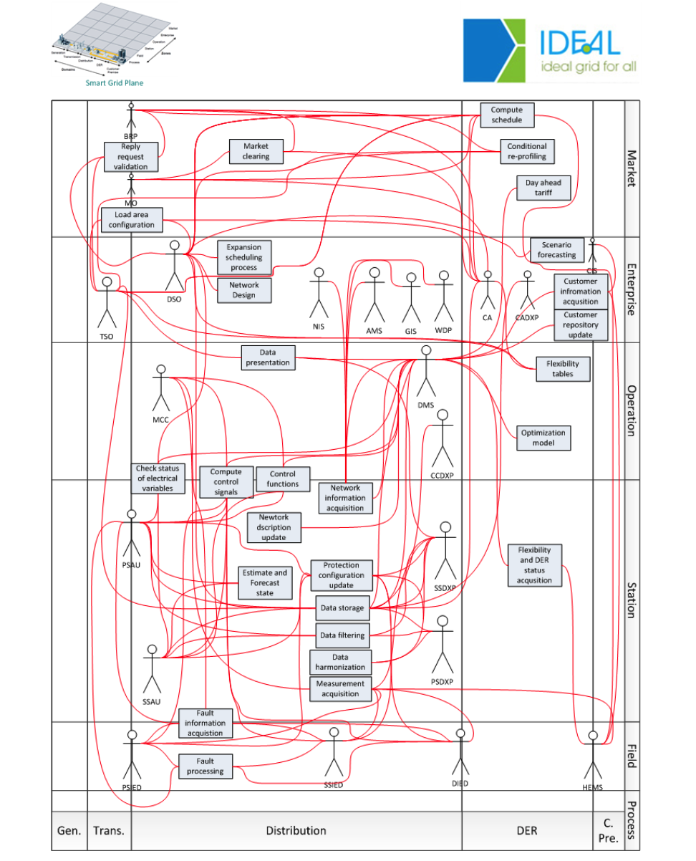
Motivation
Centralized automation
Distributed automation
(Substation Automation Units)
Interdependency of different actors
Introduction of Petri Nets
"Design and Implementation of a Substation Automation Unit.”
IEEE Transactions on Power Delivery 32.2 (2017): 1133-1142.
Notes:
Now let´s start with motivation.
With the higher grid dynamics and increasing power system control complexity, advanced distribution automation system should be deployed to ensure the normal operation of the grid,namely the distributed automation which includes substation units that this thesis focus on.
But for distributed automation system, due to the huge number of actors within the system and interdependency of different actors, the data and information exchange are chaotic and the logic chain is not clear, very detrimental for further analysis. So Petri net should be introduced to avoid these problems.

Slide 3
Aim
Goal
To propose a methodology to evaluate the performance of distribution grid automation architecture by measuring its resiliency index (dependability)
Investigate the applicability of Petri Nets for performance analysis of automation architectures
Contribution
A feasibility study on using Petri Net theory for modeling and analyzing the distribution automation system
SCPN: Stochastic Colored Petri Nets
Modeling of different use cases of IDE4L automation architecture with SCPN
Identify the most vulnerable component in DA using SCPN
STPN: Stochastic Timed Petri Nets
Design failure model of automation actors with STPN
The performance comparison of different DA architectures and protection methods using STPN
Inputs
IDE4L architecture considered as input
Concentrated on the MV Level automation architecture of IDE4L

Slide 4
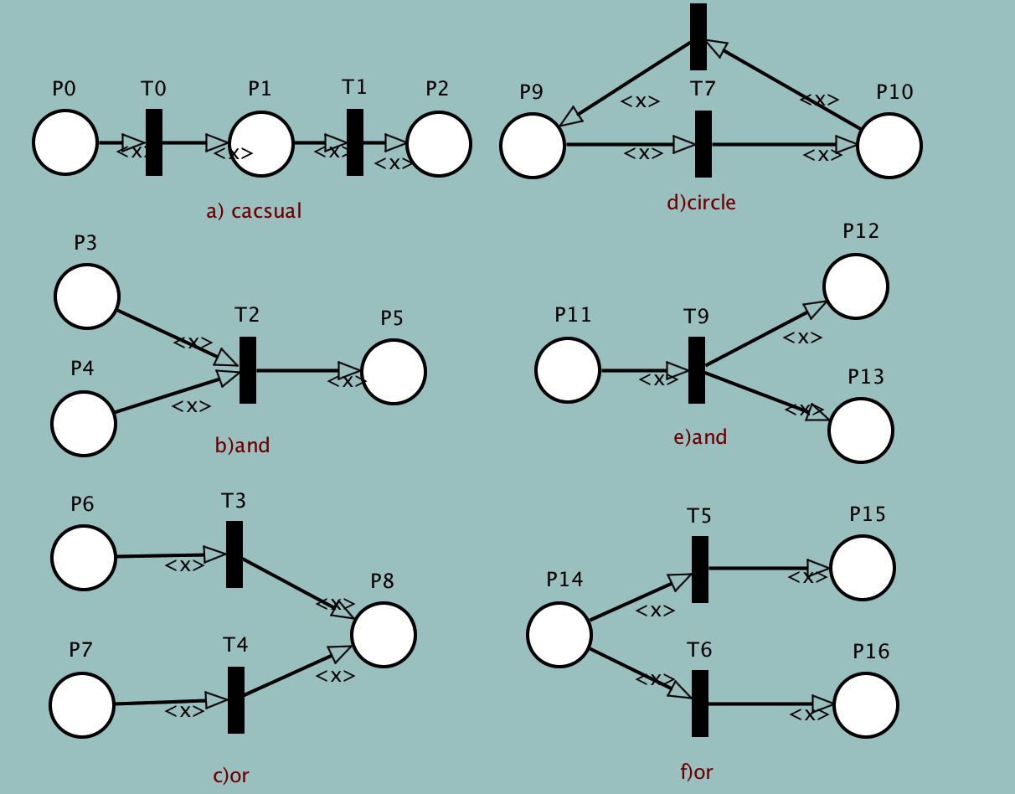
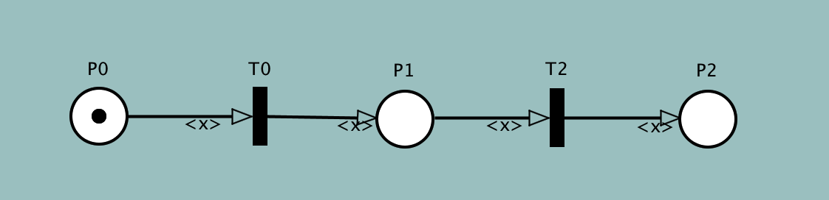
Petri Nets Basis
Petri net is a visual graphical mathematical modelling language to model static structure and dynamic change of Discrete Event Dynamic System (DEDS)
Place : a circle (P0,P1,P2)
describe possible local system states
Transition: a rectangle (T0,T2)
describe events that may modify the system state.
Arc: between place and transition
specify the relation between local states (Places) and events (Transitions)
Token: markers that reside in places
specify the PN state
A transition can fire (an event takes place) if all the transition input places contain at least one token. In this case the transition is said to be enabled.
Basic logic connections:

Slide 5
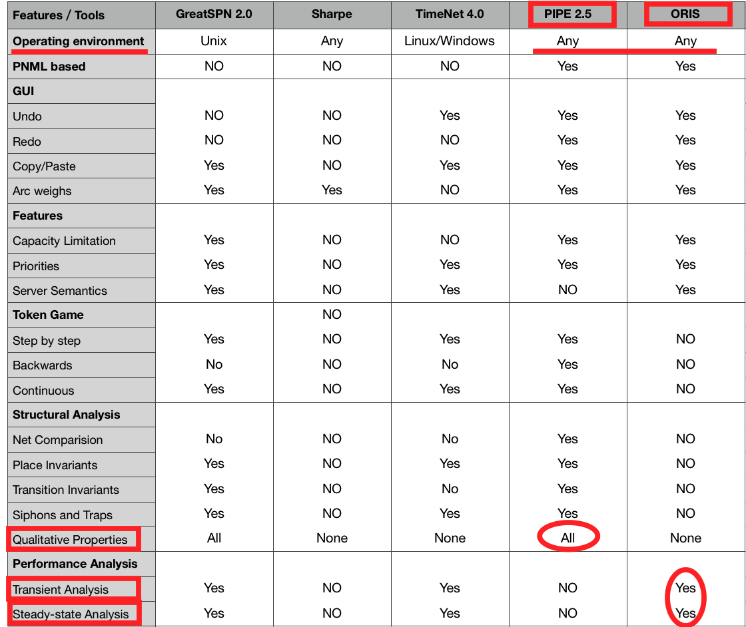
Petri Nets Types and tools
Petri net extensions
To Colored Timed Petri nets (CPN or SCPN)
to Timed Petri nets(TPN or STPN)
Stochastic Colour Petri Net (SCPN)
Identify different token tpyes in the same place
Complete more complex logical network architecture
PIPE is friendly for colored token definition
Stochastic Timed Petri Net (STPN)
transition may have time delay which is randomly chosen
ORIS has various functions for transient and steady-state analysis
We choose PIPE and ORIS as simulation tools.
Notes:
Stochastic Petri nets are a form of Petri net where the transitions fire after a probabilistic delay determined by a random variable.
Two classes of transitions exist in GSPNs:
• timed transitions, whose delays are exponentially distributed random variables
• immediate transitions, whose delays are deterministically zero
Immediate transitions have priority over timed transitions.

Slide 6
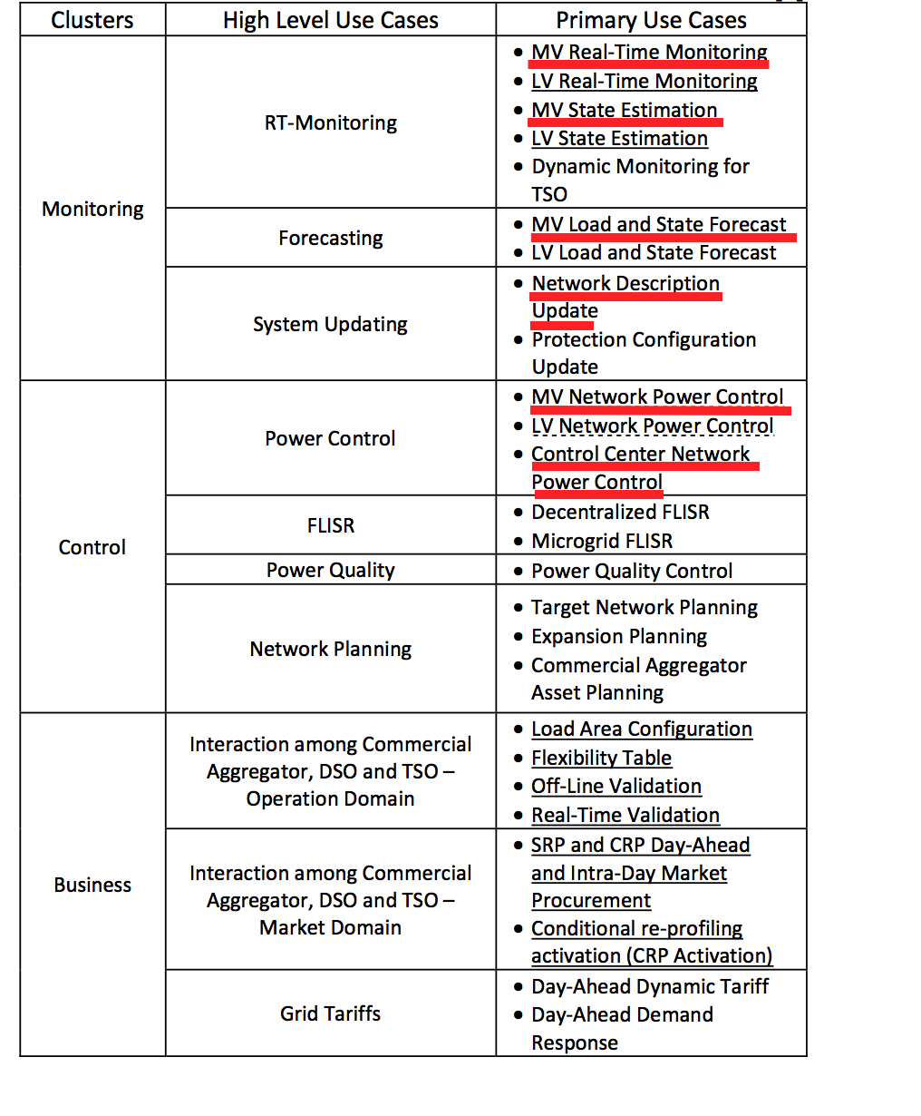
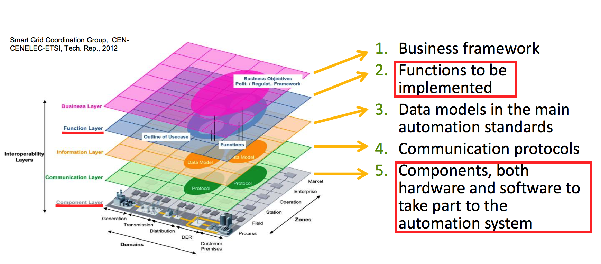
IDE4L project Automation concept and architecture
The automation architecture development of IDE4L is supported by two main concepts:
Smart Grid Architecture Model (SGAM) framework
Use Case (UC) Methodology
Deliverable 3.1: Distribution Automation Concept
Function layer： Survivability analysis
Component layer： Dependability analysis
Focus on 6 major monitoring and control use cases in MV level
MVPC,MVRTM,MVSE,MVSF,NDU,CCPC

Slide 7
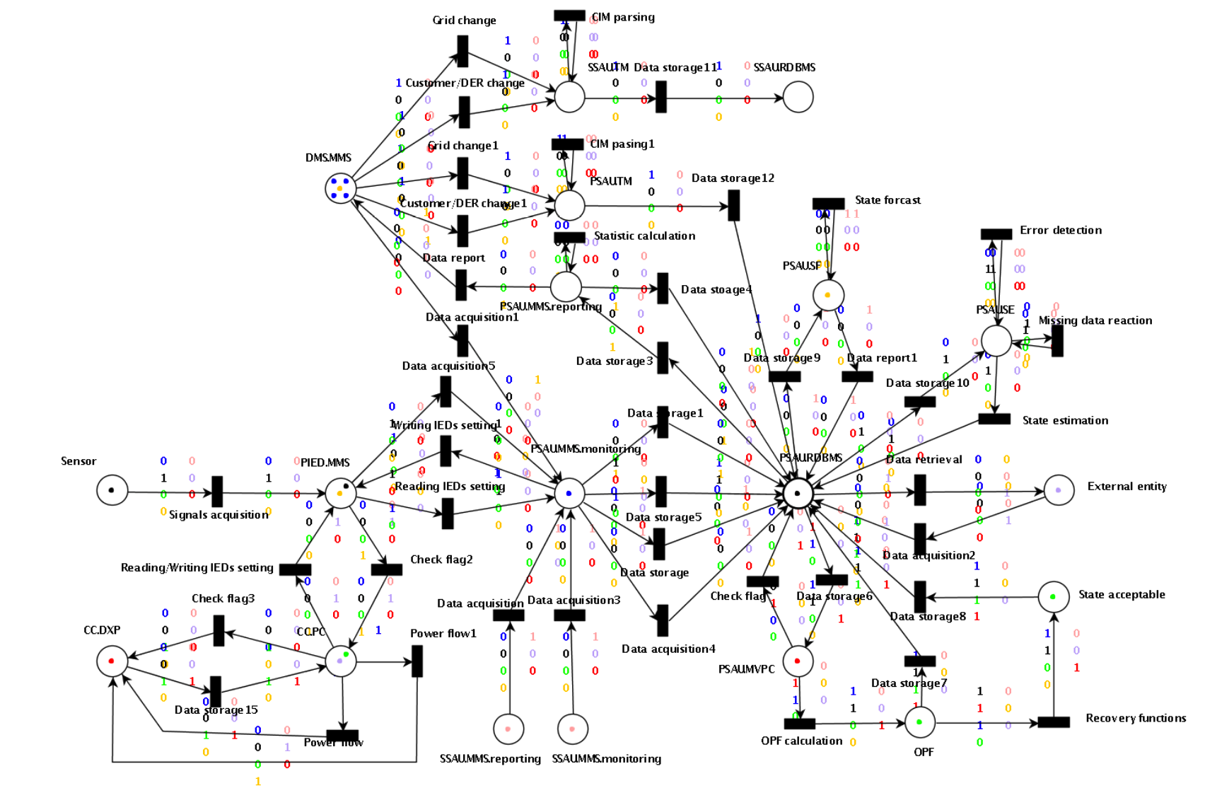
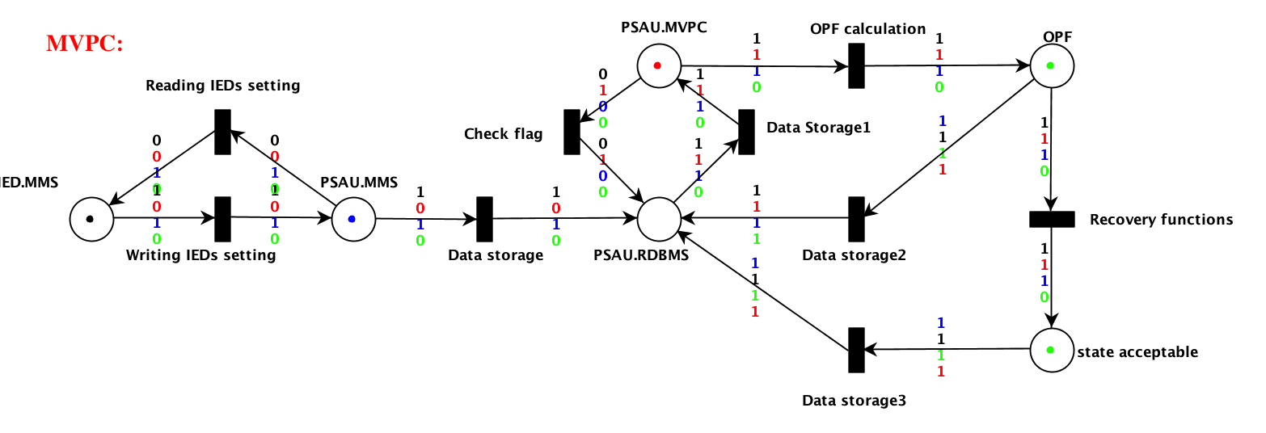
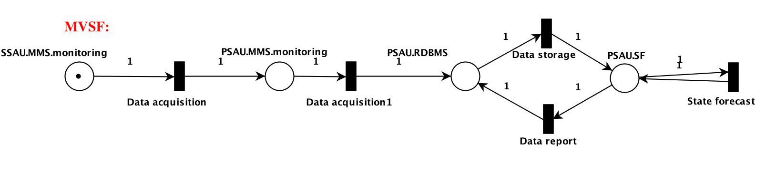
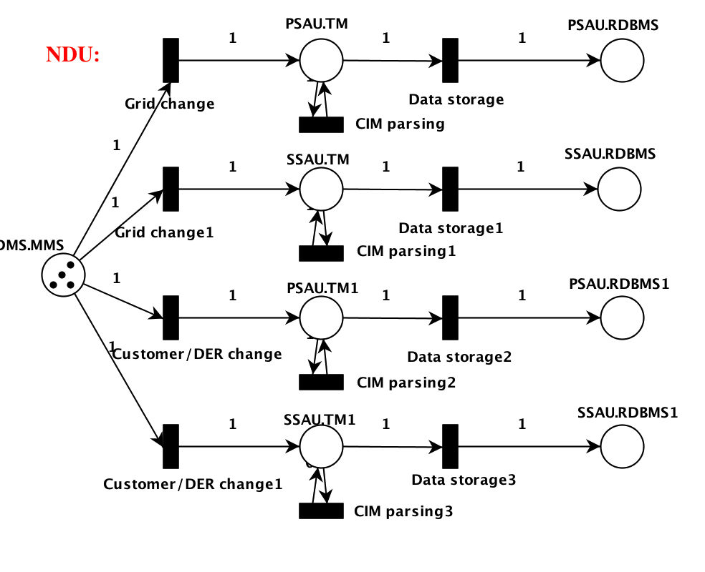
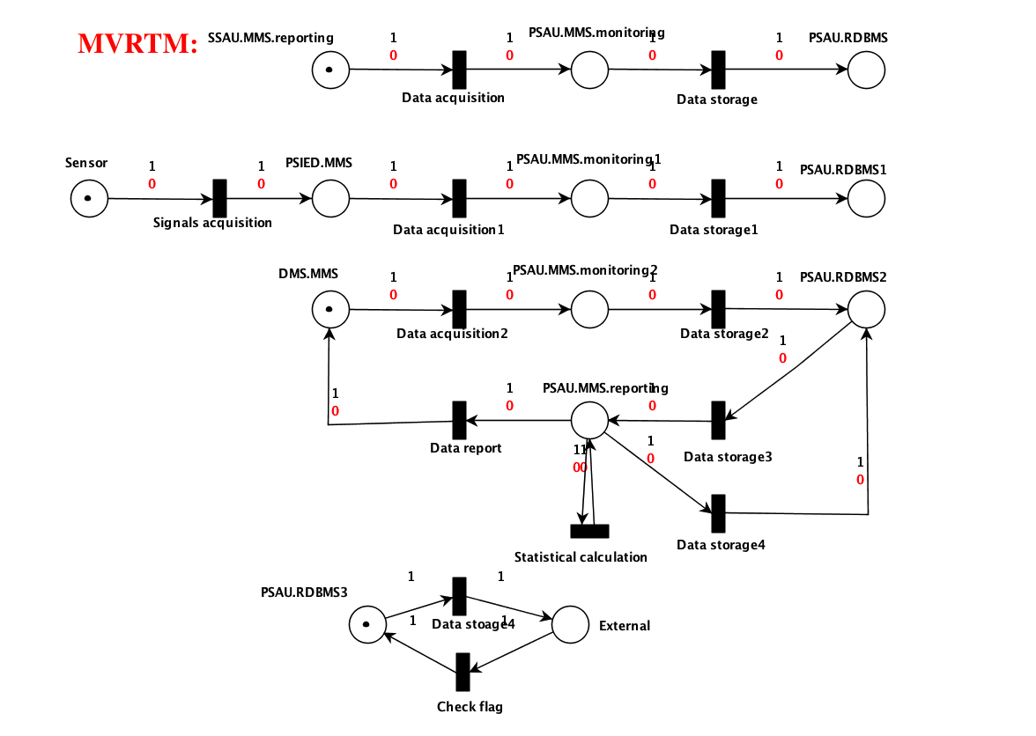
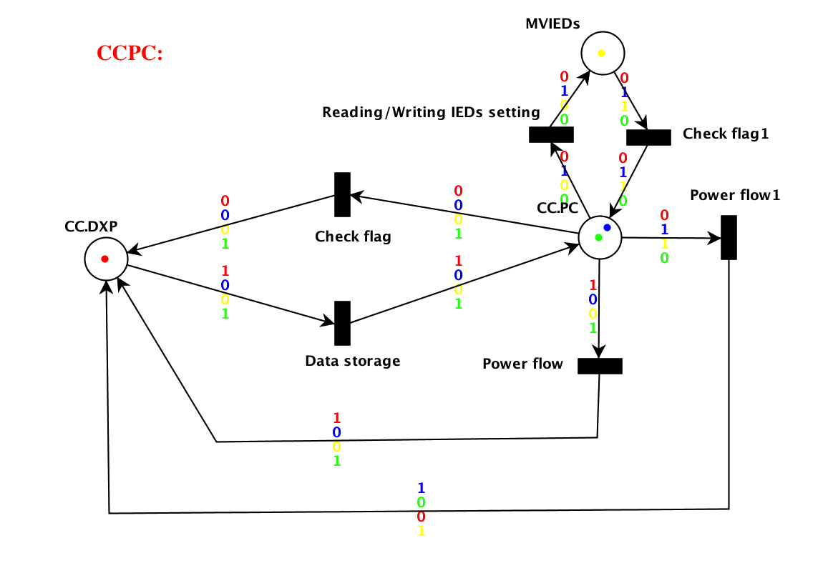
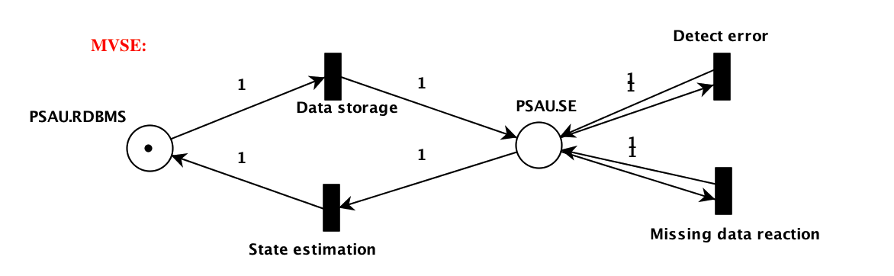
Performance analysis SCPN
MVPC,MVRTM,MVSE,MVSF,NDU,CCPC in PIPE

Slide 8
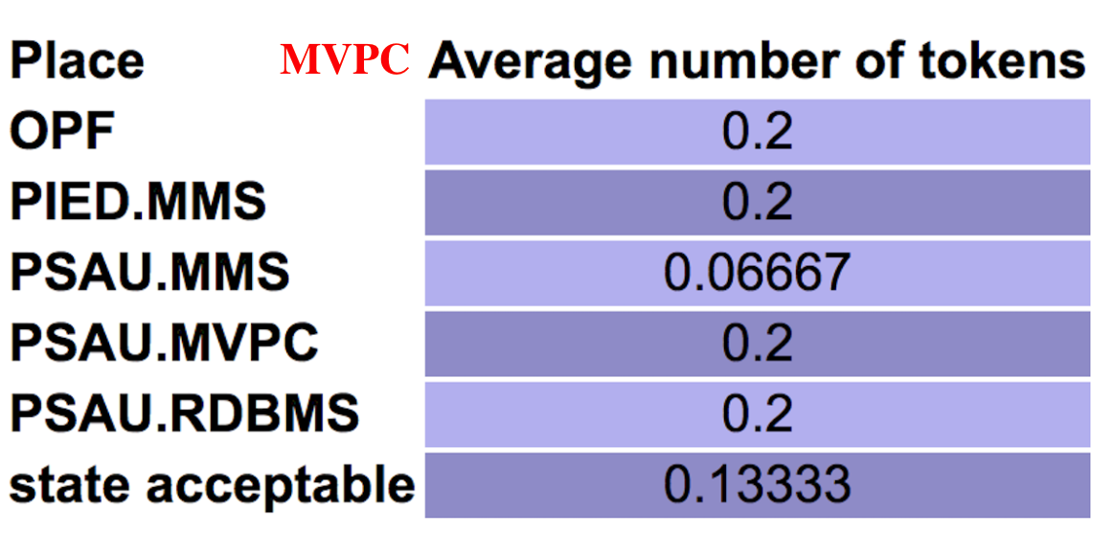
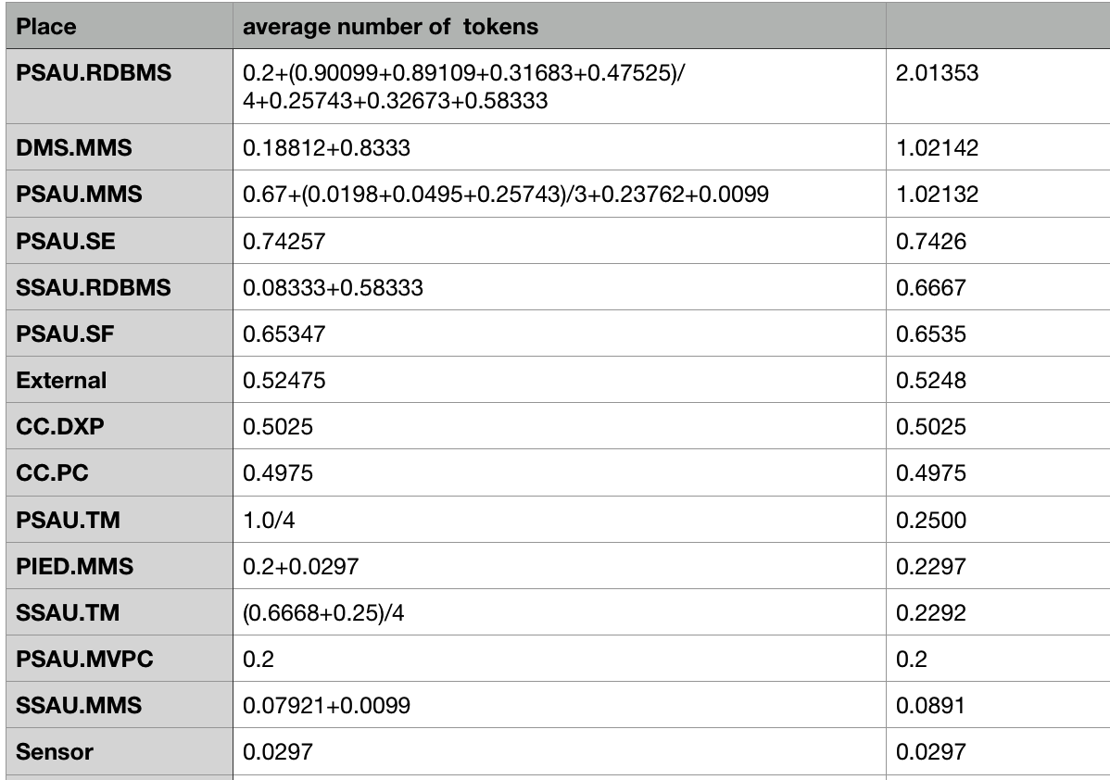
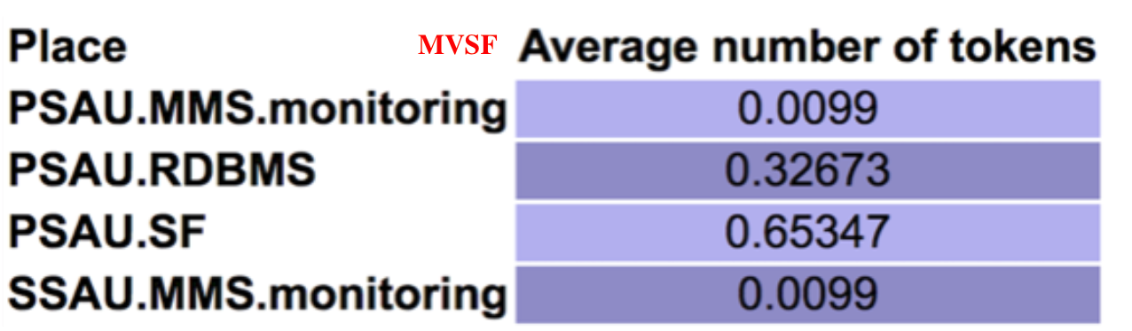
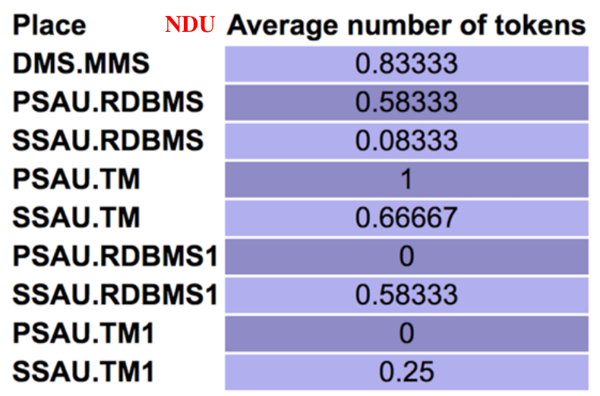
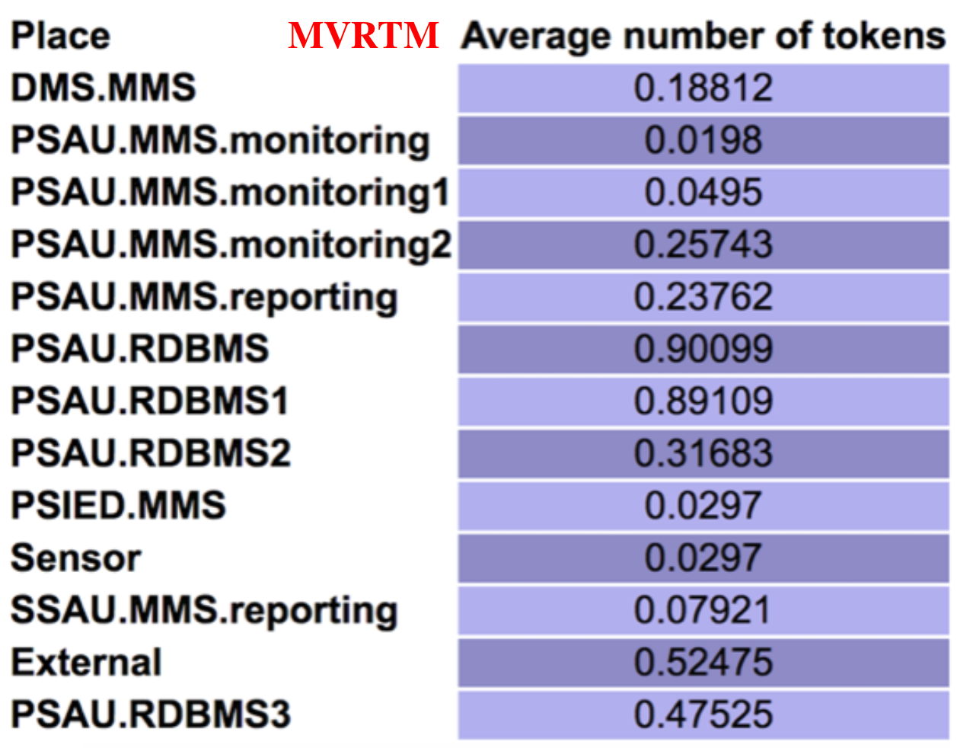
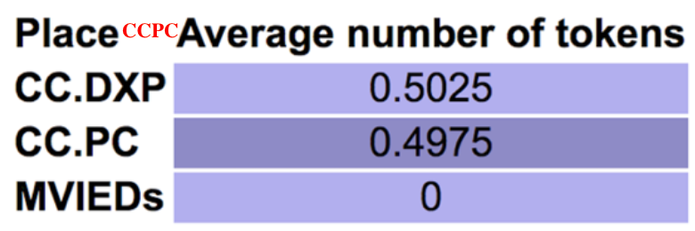
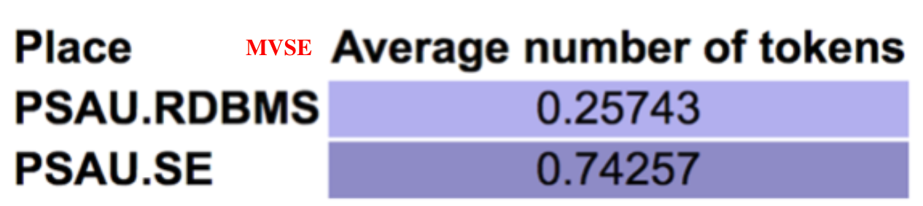
Qualitative analysis SCPN
We evaluate the importance of different components by calculating the average number of tokens passing through each place in 1000 transition firings(10 repeats )
In component level PSAU is the most vulnerable component
In function level PSAU.RDBMS (Relational database management system) has the greatest impact for survivability

Slide 9
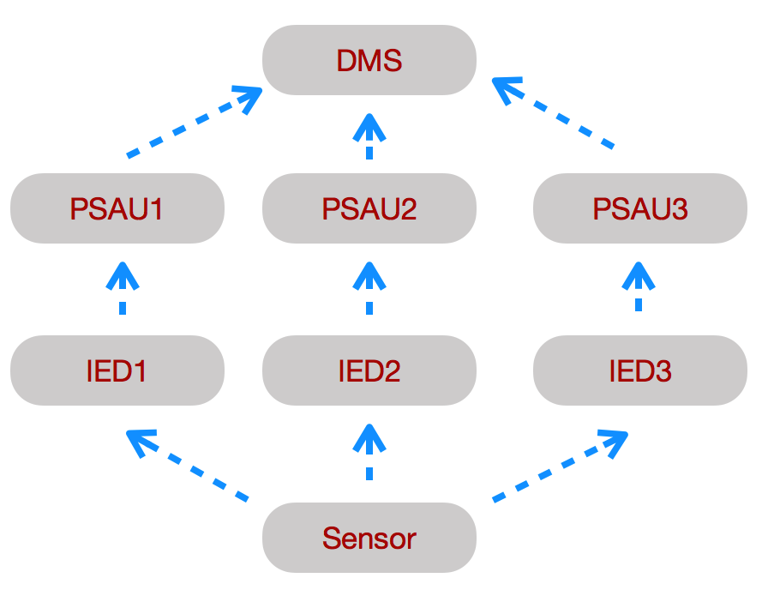
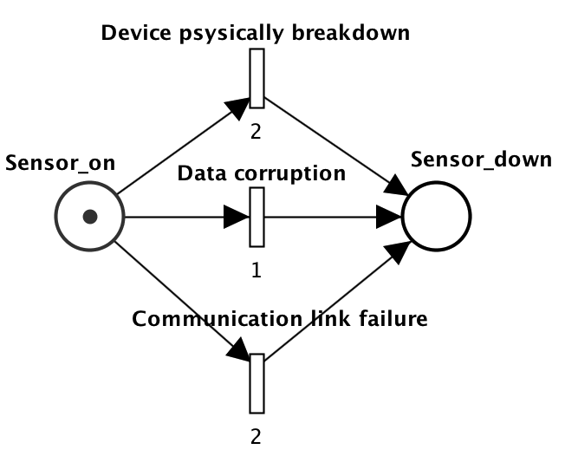
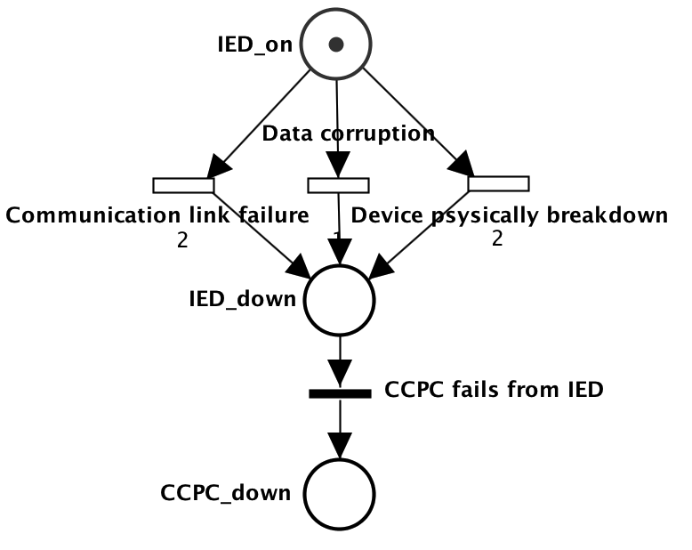
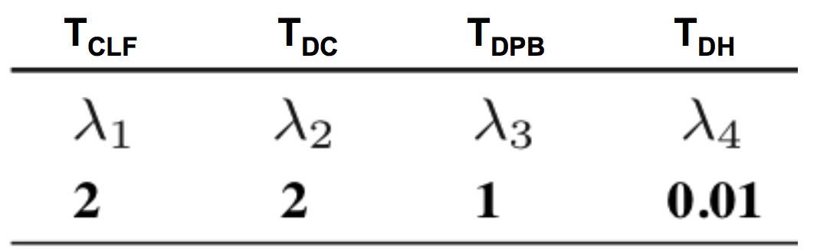
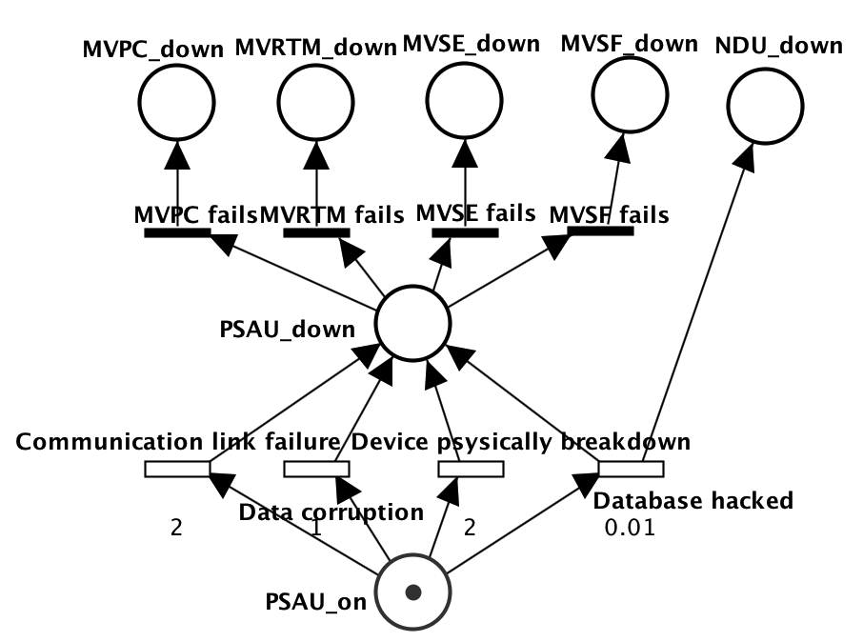
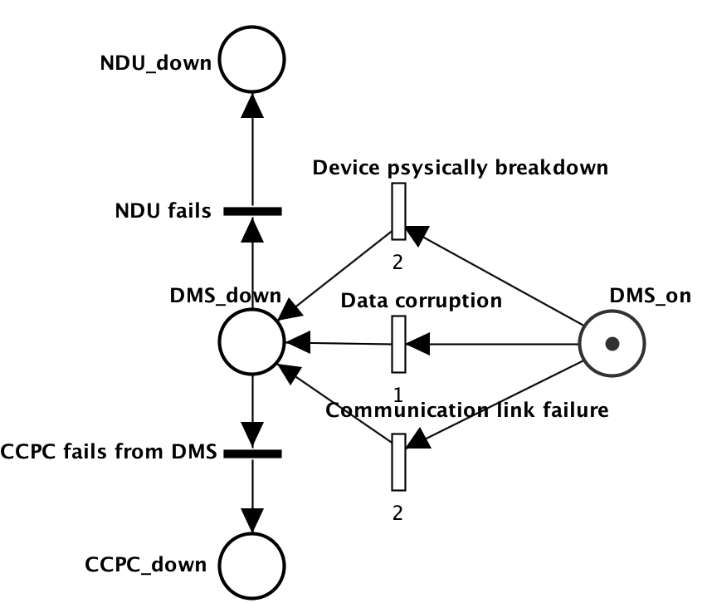
Performance analysis STPN: Definetion of failure modes
Included components:
Sensor, IED,PSAU, DMS
Failure modes:
Sensor
IED
Transition firing rates:
PSAU
DMS
TCLF: Communication Link Failure,
TDC: Data Corruption,
TDPB: Device physically Breakdown,
TDH: Database Hacked
Source:Zeng, Rongfei, et al. "Dependability analysis of control center networks in smart grid using stochastic petri nets.”

Slide 10
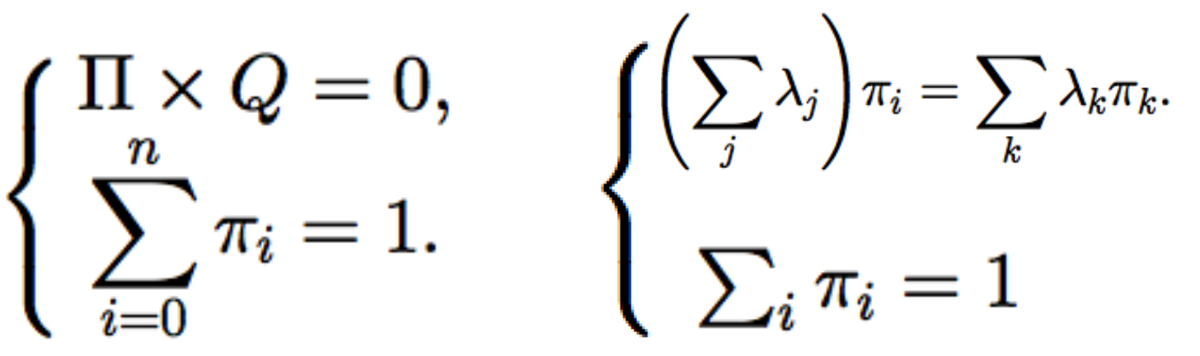
Performance analysis STPN: Calculation method of dependability
Calculation method of dependability for both steady-state and transient aspects:
the analysis of the equivalent Continuous Time Markov Chain (CTMC)
the computation of dependability(Two methods):
ORIS's own performance analysis tools(GSPN) can quickly obtain analysis results (steady-state failure probability) both in data and graph.

Slide 11
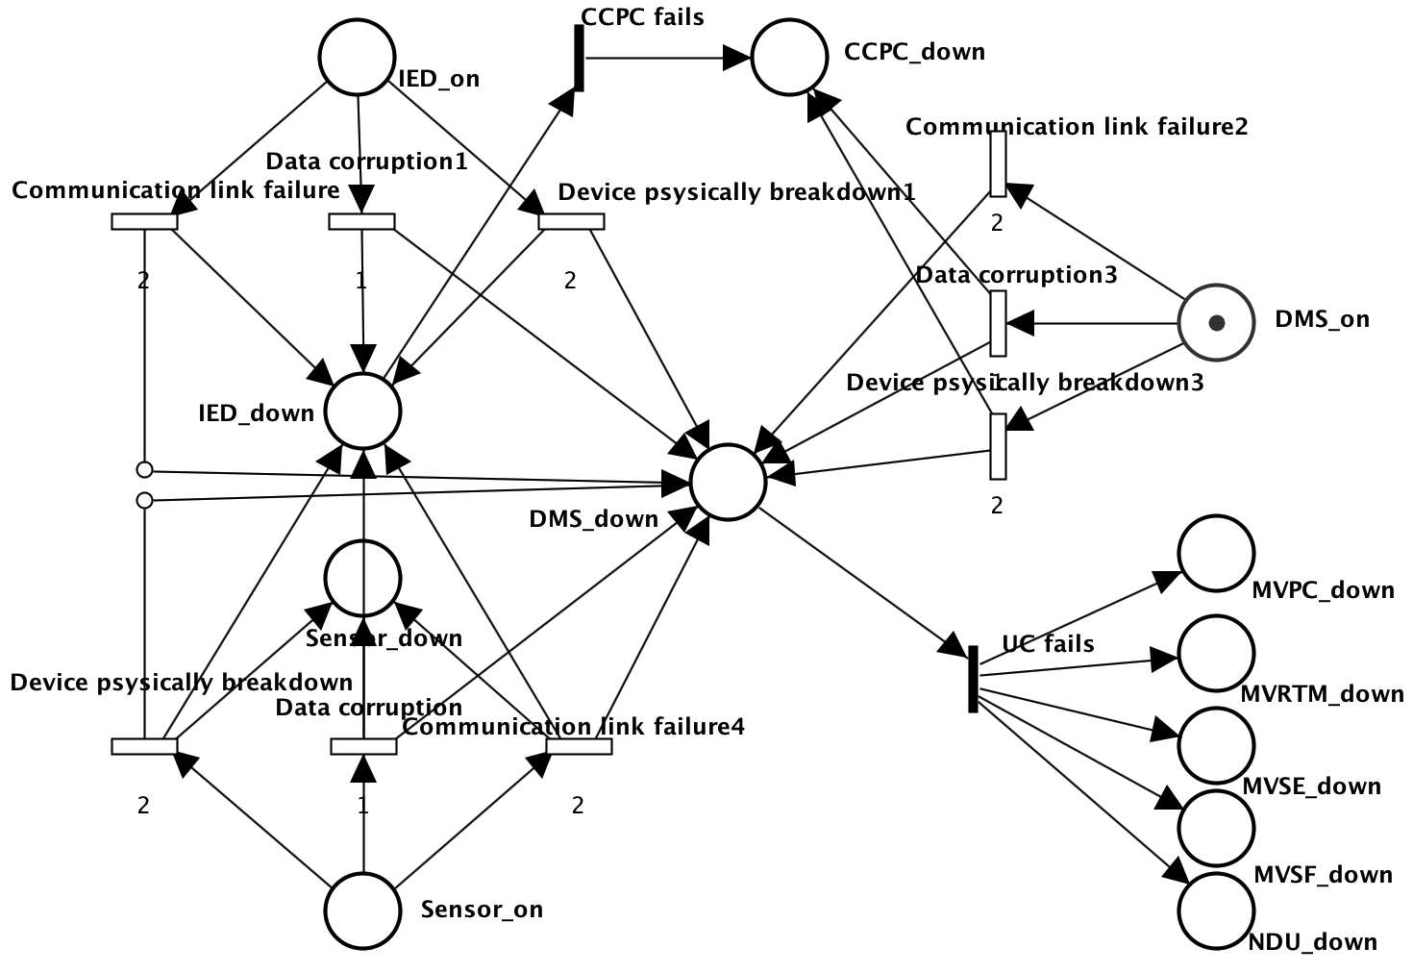
Performance analysis Centralized Automation(CA)
Centralized automation(CA) architecture
only one Sensor, one IED and one DMS

Slide 12
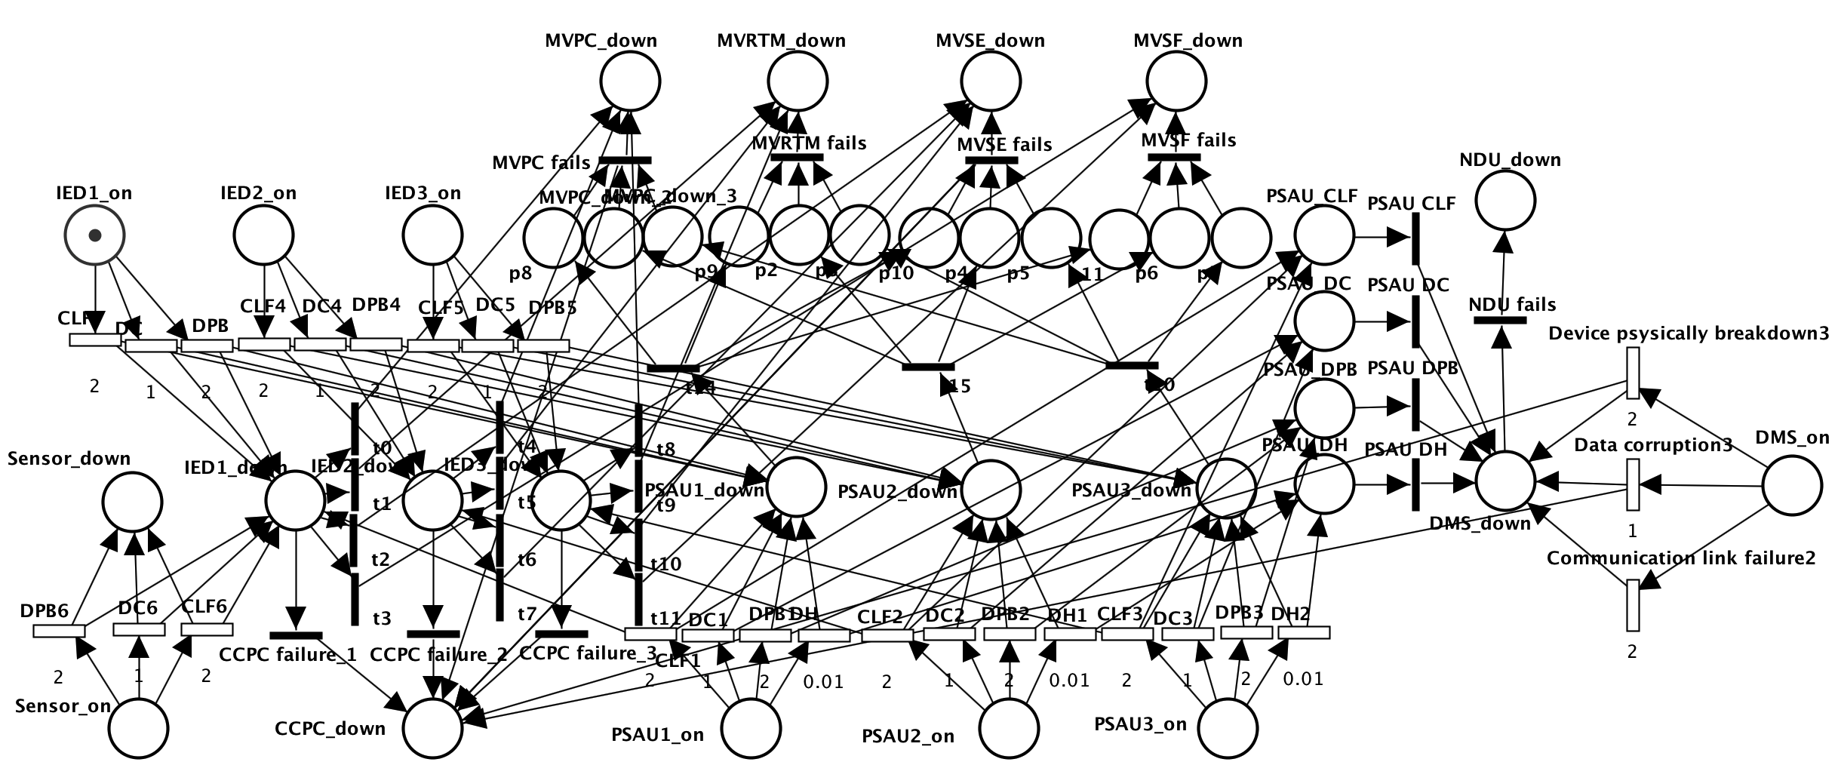
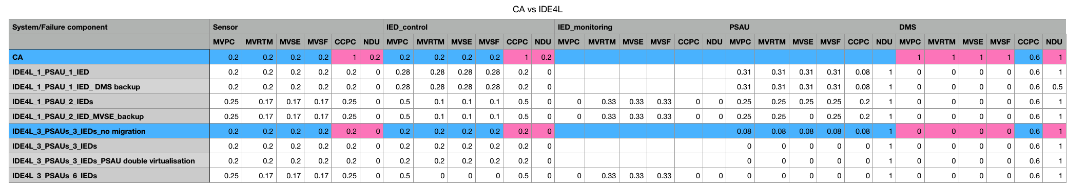
Performance analysis IDE4L
IDE4L architecture
One Sensor, three IEDs, three PSAUs and one DMS

Slide 13
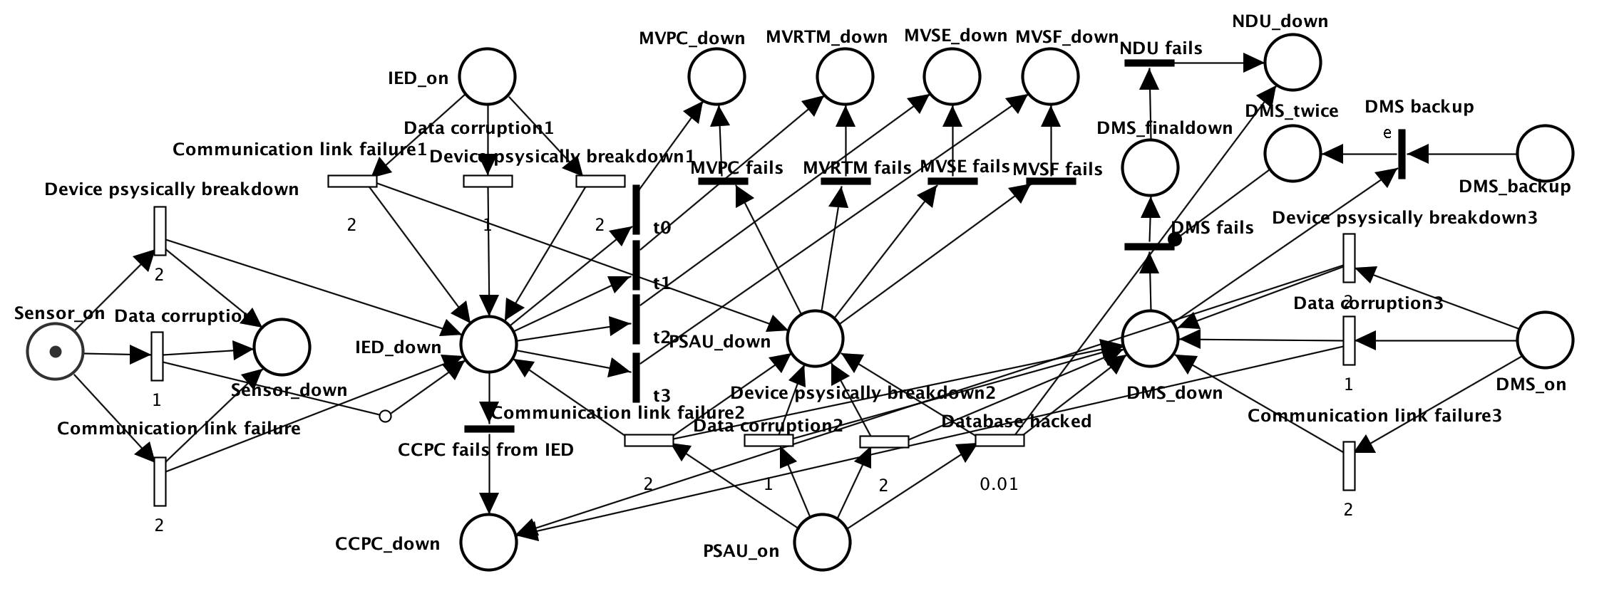
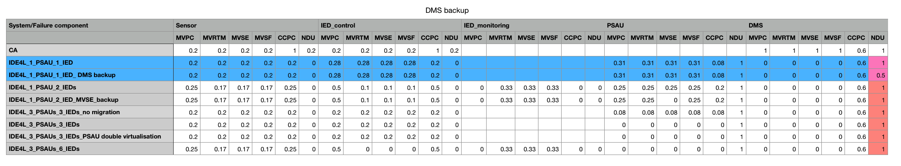
Protection approaches DMS-backup strategy
IDE4L automation distribution architecture with DMS-backup strategy
one Sensor, one IED, one PSAU and one DMS with Backup

Slide 14
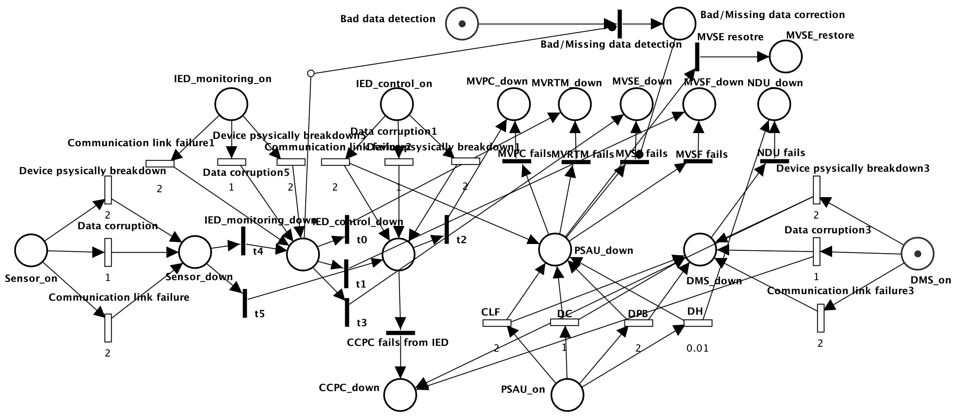
Protection approaches Bad/Missing data detection/correction
IDE4L automation distribution architecture with Bad/Missing data detection/correction
One Sensor, two separated IEDs, one PSAU and one DMS

Slide 15
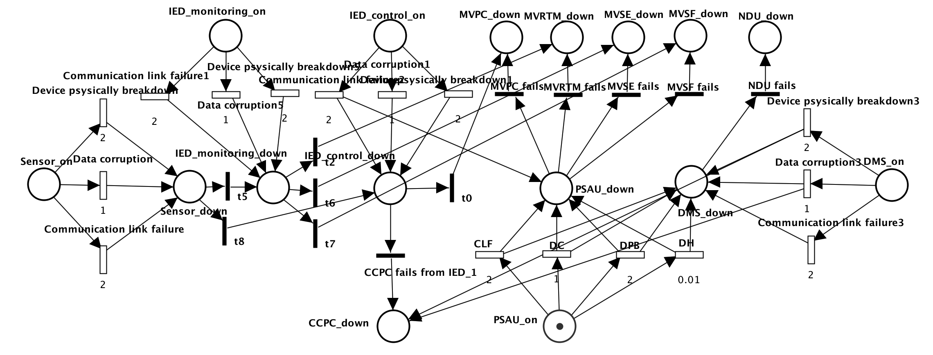
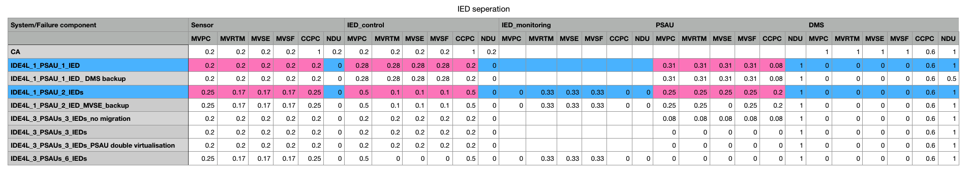
Protection approaches IED separation
IDE4L automation distribution architecture with separated IEDs
one Sensor, two IEDs ( IED_control;IED_monitoring), one PSAU and one DMS

Slide 16
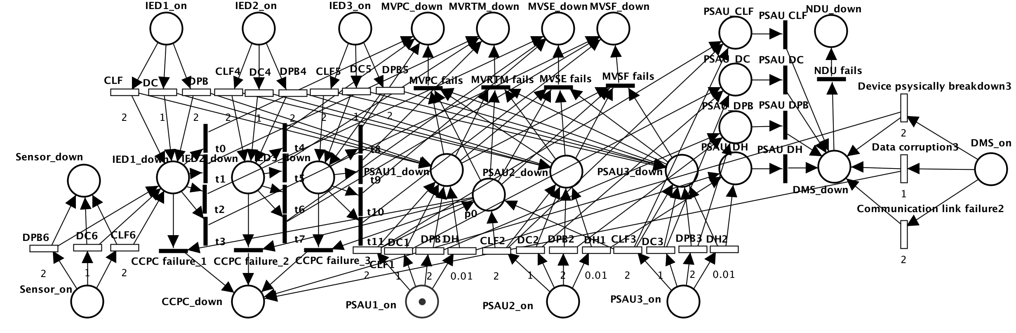
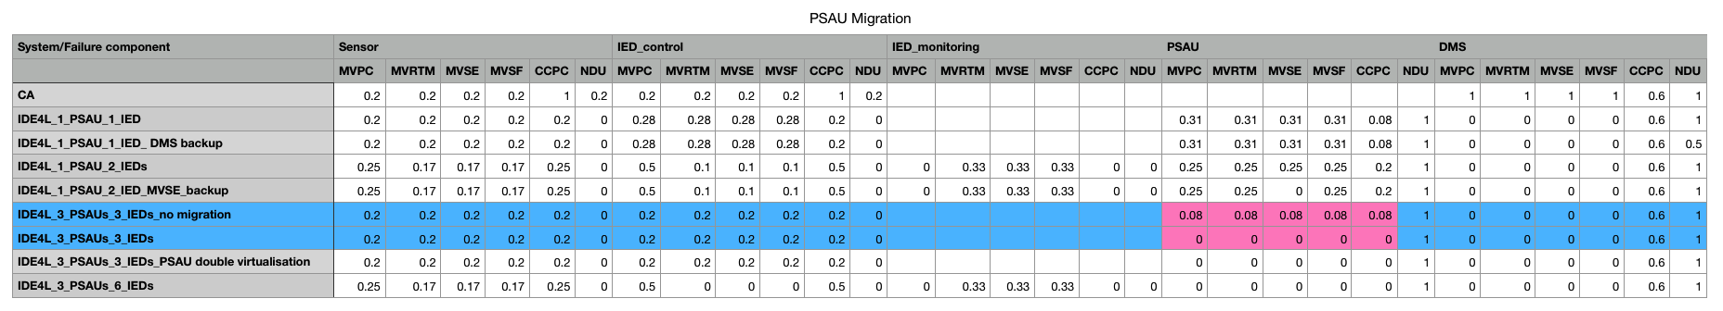
Protection approaches PSAU migration
IDE4L automation distribution architecture with PSAU migration (migration both functions and database）
one Sensor, three IEDs, three PSAUs and one DMS

Slide 17
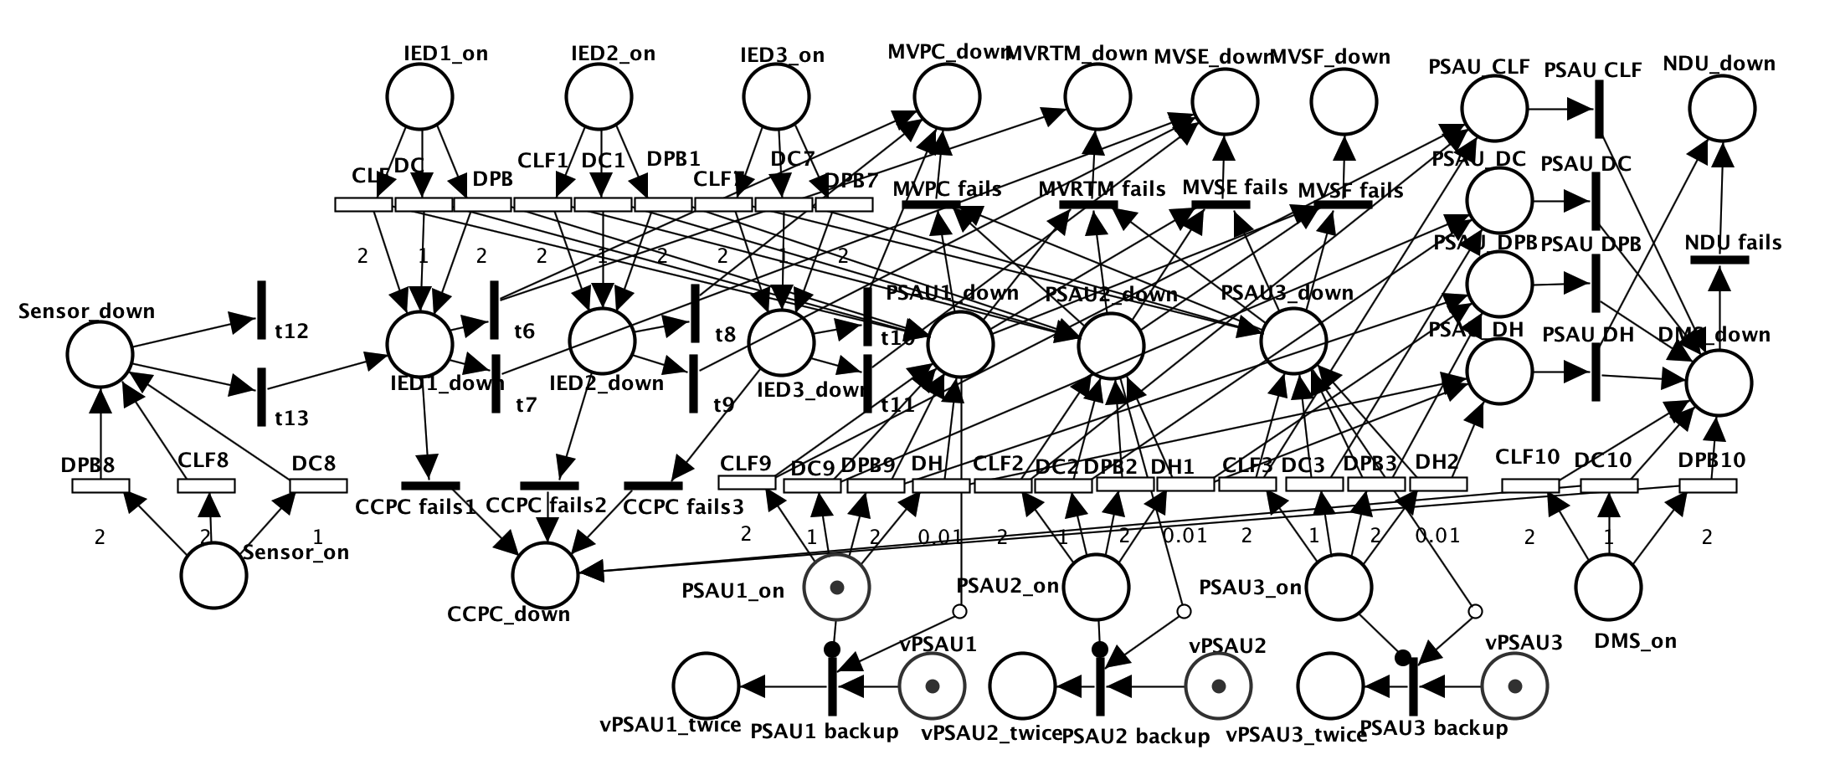
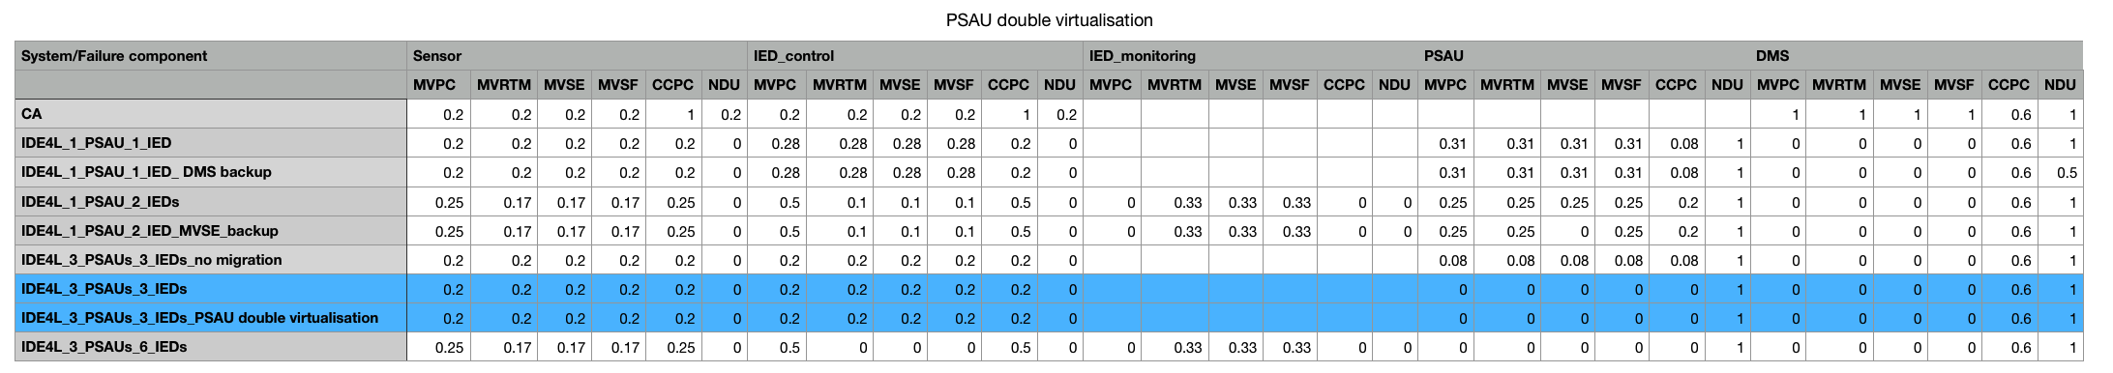
Protection approaches PSAU double virtualization
Double virtualization: The functional and data layers, which will contain functional and data entities, will be logically separated.
One Sensor, three IEDs, three PSAUs, three vPSAUs and one DMS

Slide 18
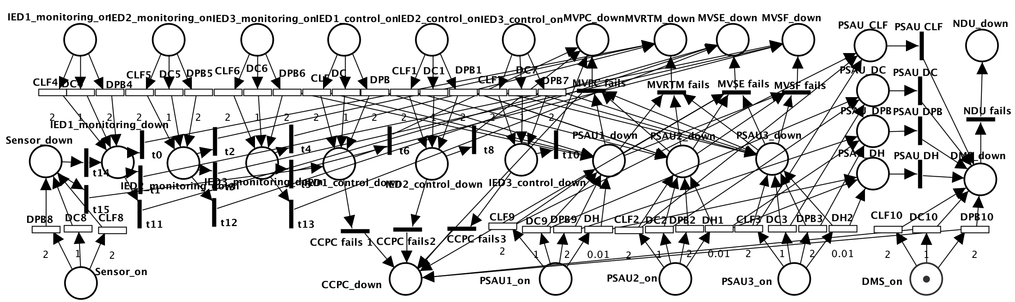
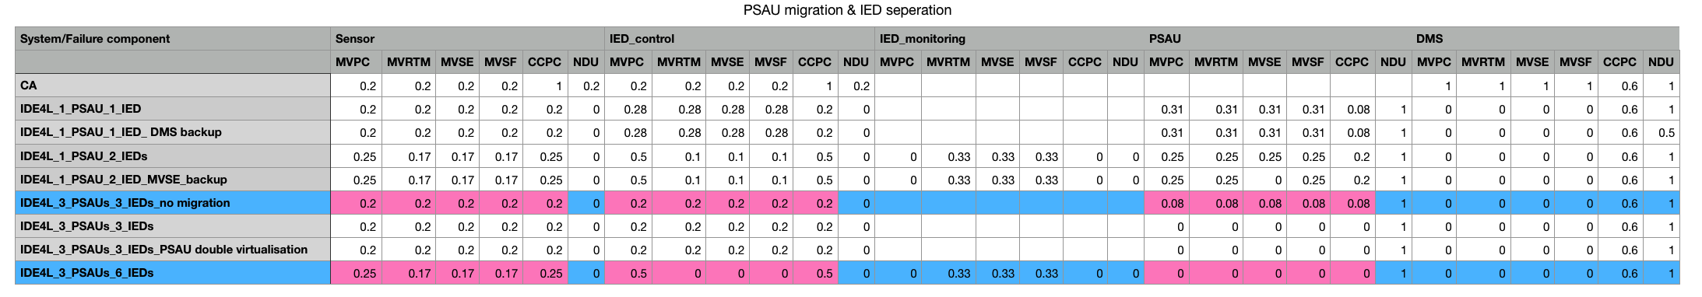
Protection approaches IED separation & PSAU migration
IDE4L automation distribution architecture with PSAU migration and separated IEDs
one Sensor, six IEDs, three PSAUs and one DMS

Slide 19
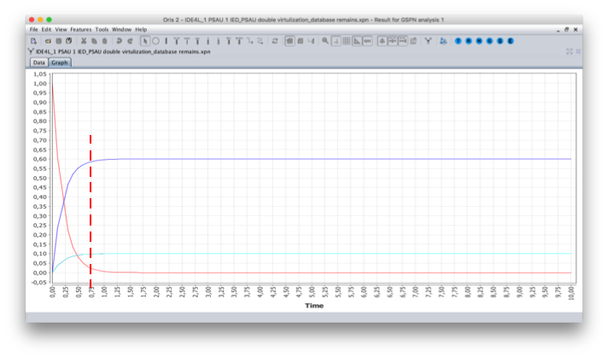
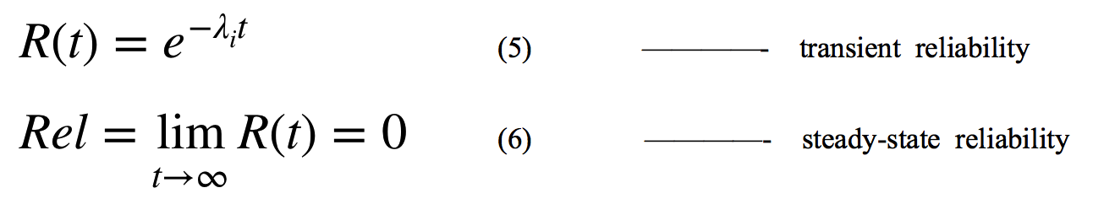
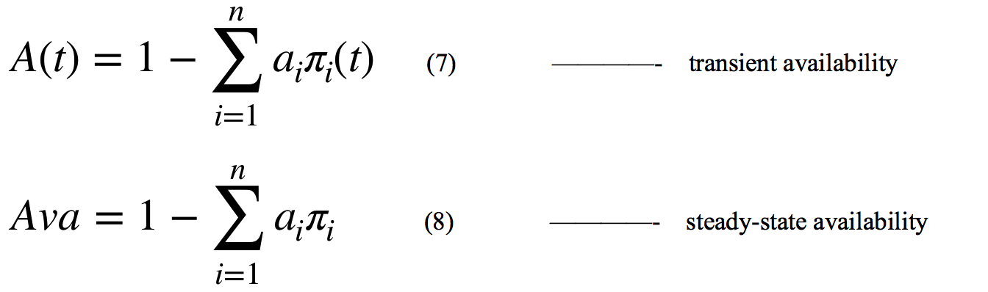
Performance analysis KPI: Key Performance Indicator
1.Reliability
The capability of each component to continuously provide services without failures.
2.Availability:
The capacity to recover quickly from difficulties for some critical components
Transient period is very short (less than 1s).
Steady state reliability remains 0
Using steady state availability as the KPI.

Slide 20
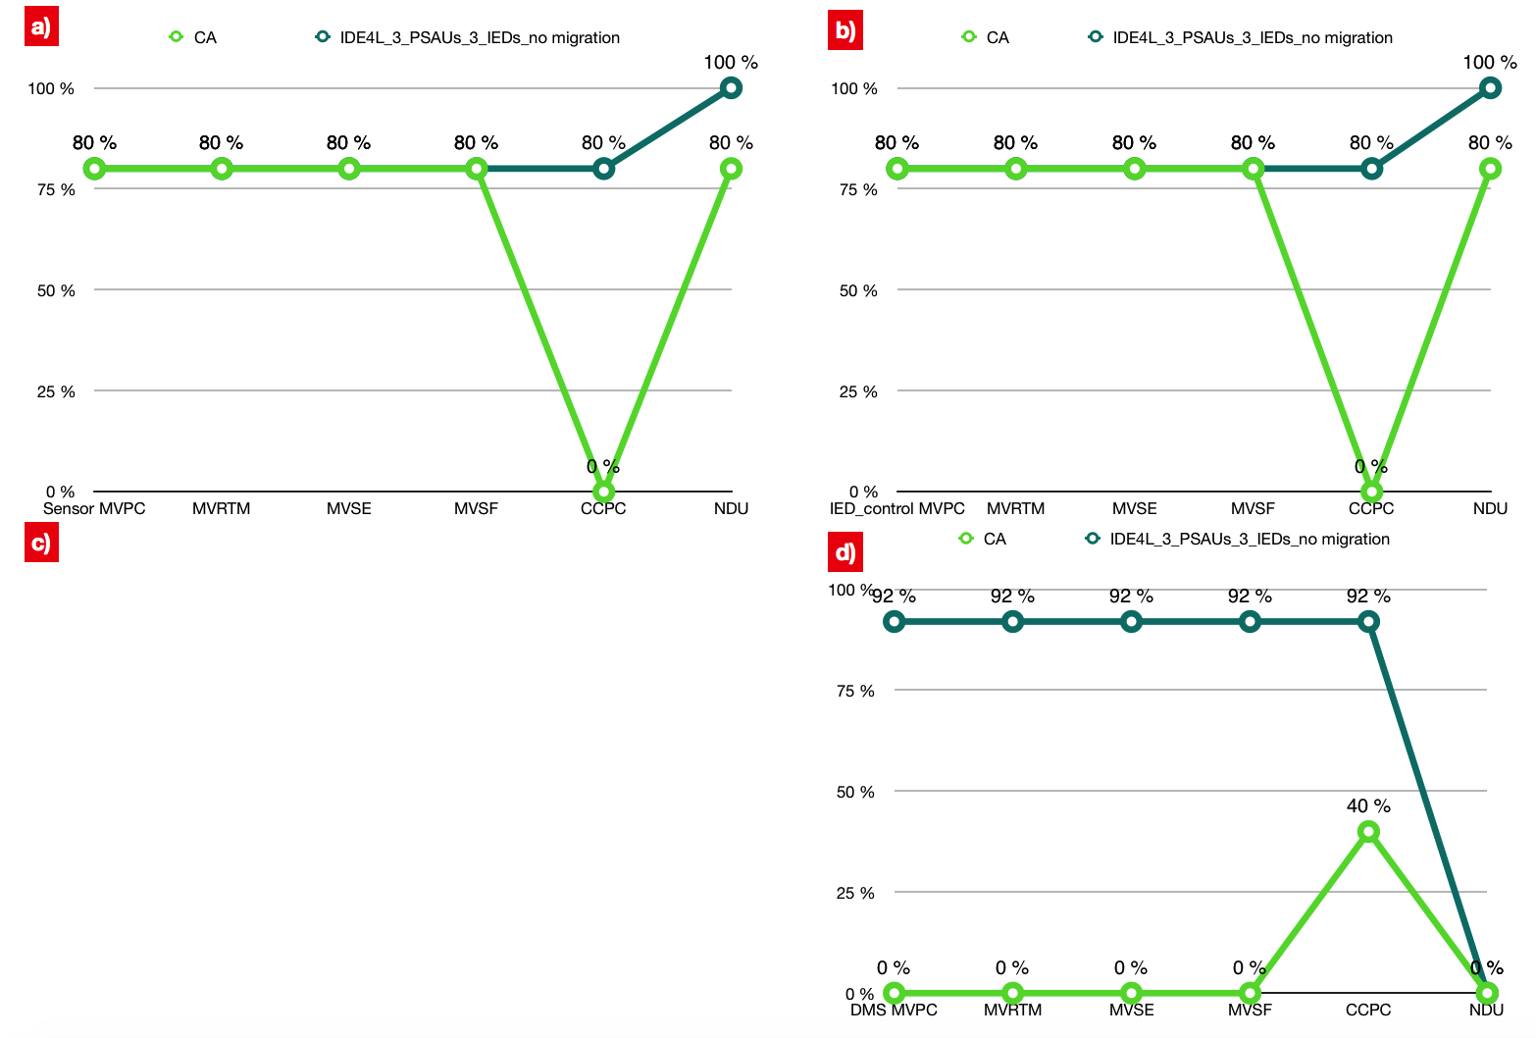
KPI Steady state availability
Compared with centralized automation,IDE4L can significantly improve the availability of most use case.
Availability of a few use cases decrease, which can be avoided through following protection approaches.
a)in case of sensor failure
b)in case of IED_control failure
c)in case of PSAU failure
d) in case of DMS failure
e)In case of IED_monitoring failure

Slide 21
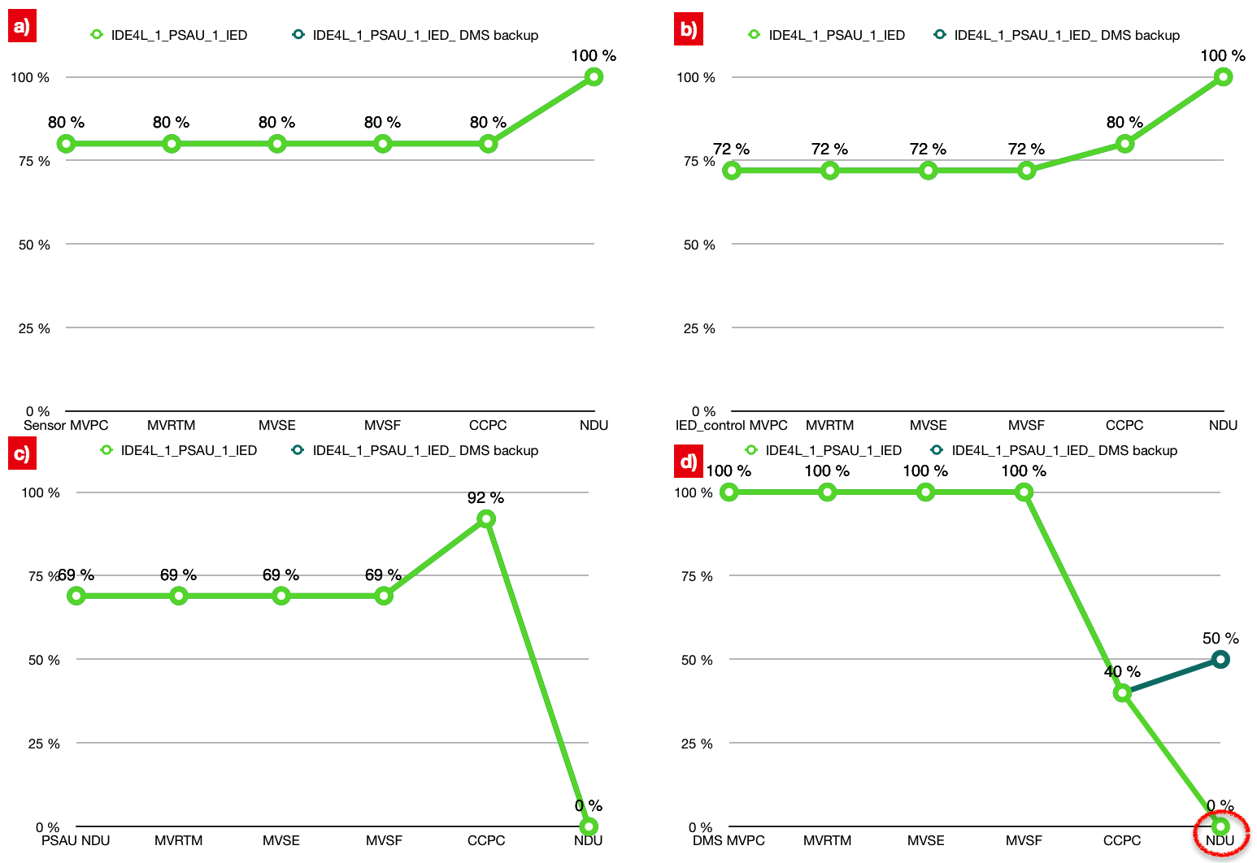
KPI Steady state availability
DMS backup strategy is most targeted for the protection of DMS，especially irreplaceable for NDU.

Slide 22
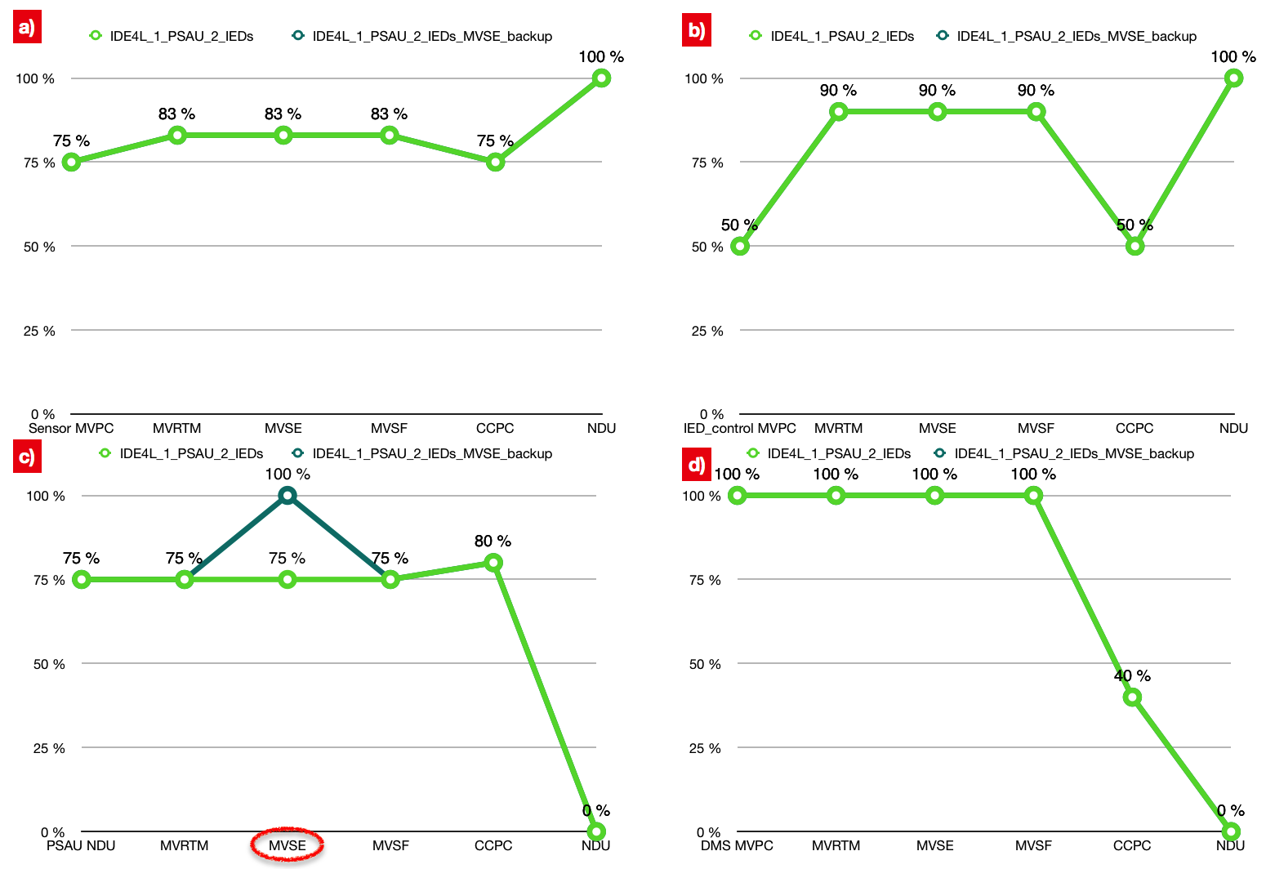
KPI Steady state availability
Bad/Missing data detection/correction mainly protects MVSE in case of PSAU failure.

Slide 23
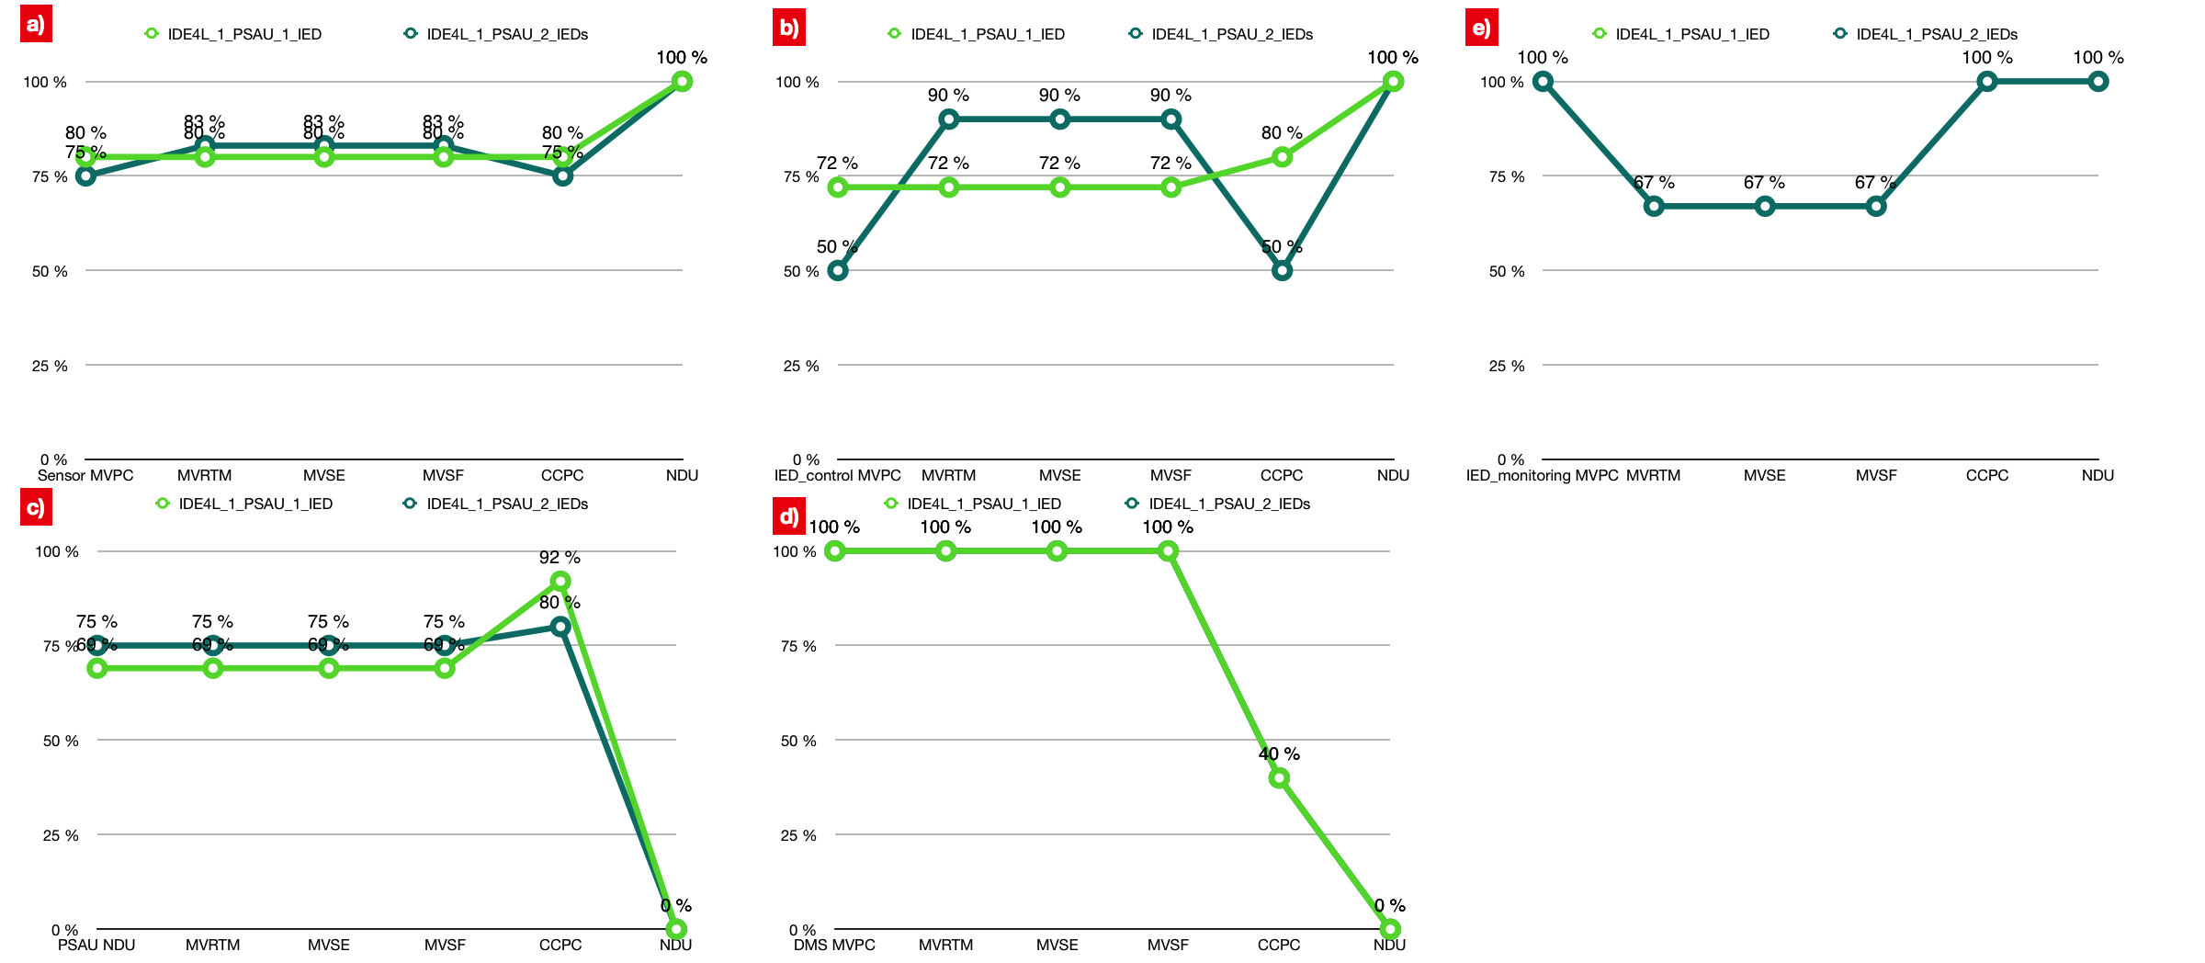
KPI Steady state availability
The functional separation on IED can improve the availability most use cases in case of Sensor, IED and PSAU failure.

Slide 24
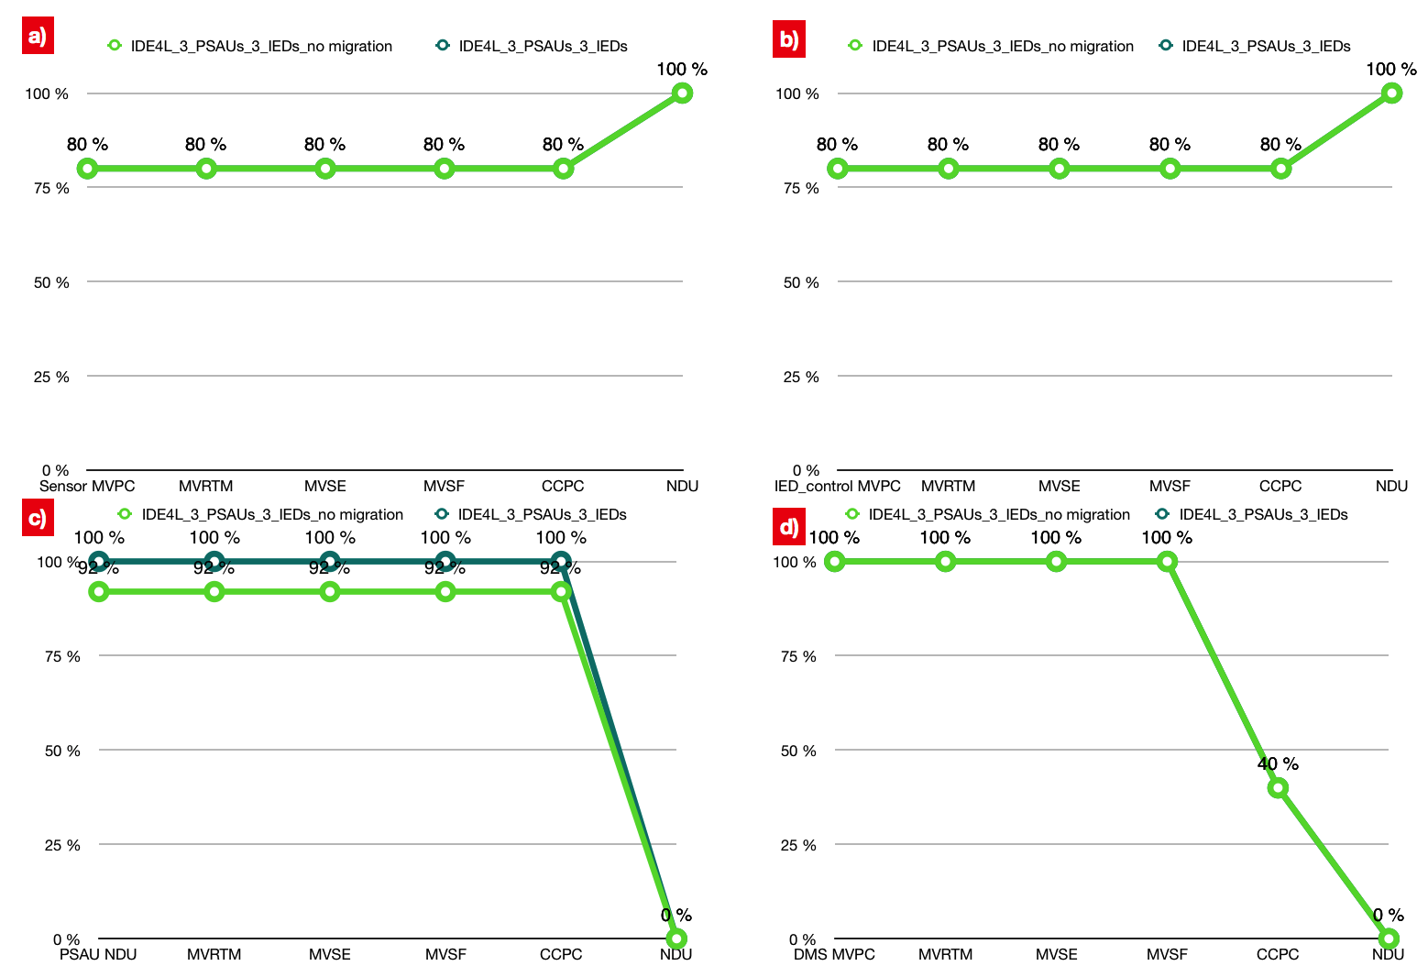
KPI Steady state availability
PSAU migration has a strong protective effect for most use cases in case of PSAU failure.

Slide 25


KPI Steady state availability
PSAU double virtualization and PSAU migration logically have the same affect.
One part of double virtualization (database or function) down result as the no migration situation
PSAU double virtualization is more critical than PSAU migration

Slide 26
Conclusion
Summary
The Goal to evaluate the feasibility of Petri Nets of modeling a distribution automation system
Basic UCs in MV level presented (SCPN)
Modeling the failure modes (STPN)
Quantification of the system performance is presented
Survivability
Dependability
Overview of different protection approaches
Future work
Detailed transition procedure modeling (e.g. communication process)
Analysis of more components fail at same time
Large scale modeling in single PN (entire automation system of an exemplary DSO)

Slide 27
Thanks for your attention!
Any question?
Contact
E.ON Energy Research Center
Mathieustraße 10
52074 Aachen
Germany
Huiyuan Xiao
T +49 17681596277
Huiyuan.Xiao@eonerc.rwth-aachen.de

